Slide 1

BEEF
THE BROWSER EXPLOITATION FRAMEWORK

Slide 2

Overview
What is BeEF?
Getting started
Browser hooking
Attack vectors/exploits & examples
Demo
Q & A

Slide 3
What is BeEF?
Short for “Browser Exploitation Framework”
open-source penetration testing tool used to test and exploit web application and browser-based vulnerabilities.
At a basic level, it allows an attacker to control a victims browser
Can be used to leverage existing vulnerabilities (XSS, CSRF,etc.)
In some cases, it can lead to full compromise of the victims PC

Slide 4
ARCHITECTURE

Slide 5
Getting Started
Installed by default on Kali Linux
Can also be downloaded from http://beefproject.com/
App directory /usr/share/beef-xss/
Startup script /etc/init.d/beef-xss <start|stop>
Web UI http://localhost:3000/ui/panel/
Default user/pass: beef/beef

Slide 6
Logging In…

Slide 7
Attack Vectors
Social Engineering/Phishing - Lure or convince victim to attacker controlled server hosting BeEF
Open Redirect - Redirect victims automatically to attacker controlled server hosting BeEF
Reflected XSS - Send victim a URL that executeshook.js script
Stored XSS - Embed hook.js script via a stored XSS vector
Man-In-The-Middle Attacks - Injecting BeEF hook via MITM

Slide 8
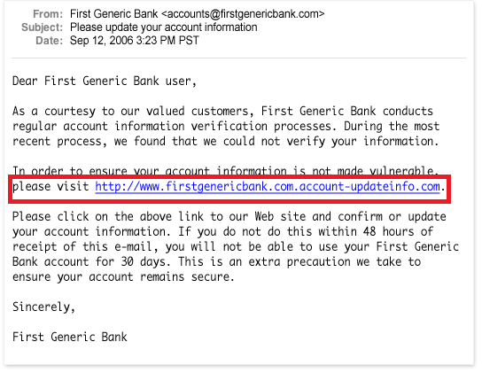
Phishing & Social Engineering
It only takes one wrong click…

Slide 9
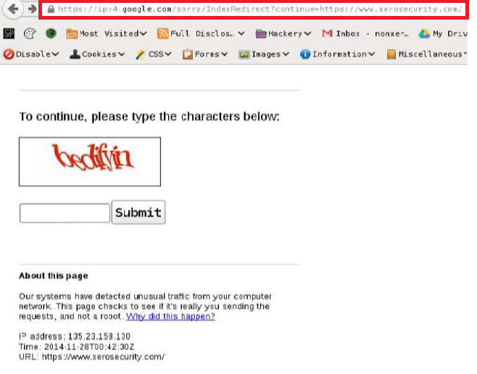
Open Redirect

Slide 10
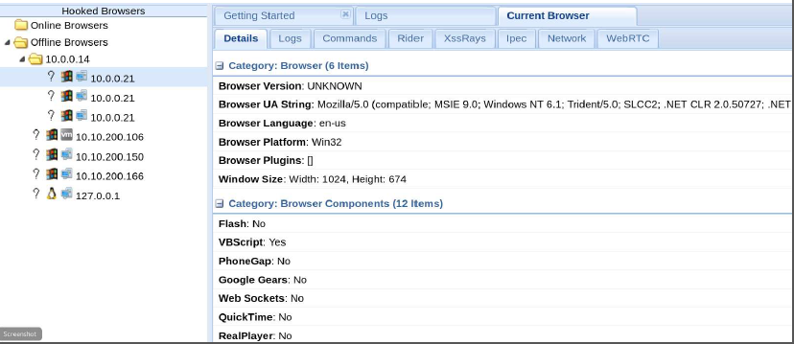
Web UI
Tracks client connections (ie. hooked browsers) and allows an attacker to run modules

Slide 11
Attacks
Gather intel on target system/browser
Retrieve session cookies
Redirect target to malicious URL’s
Change site content
Form field sniffing
Embed hidden iframes
Alter original page content (HTML/JS)
Scan internal network (ping/port scans)
Launch CSRF attacks
Execute client-side exploits/code (BeEF/Metasploit/SET)

Slide 12
Modules

Slide 13
Browser Hacking Methodology
Gaining control
Fingerprinting
Retain control
Bypassing SOP
Attacking users
Attacking extensions
Attacking web applications
Attacking browsers
Attacking plugins
Attacking networks

Slide 14
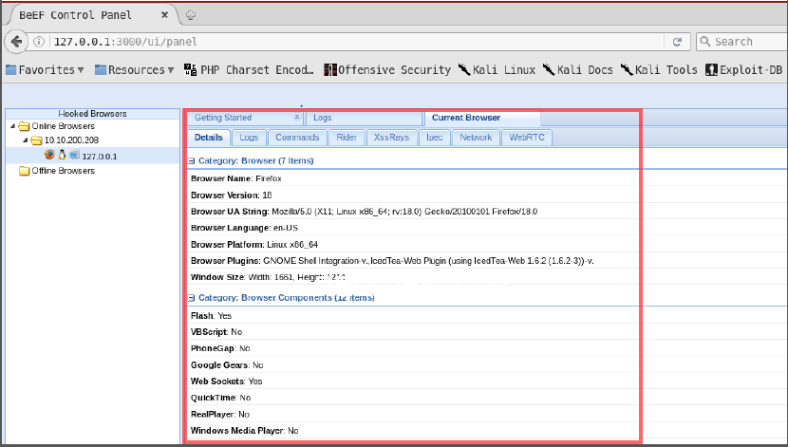
Fingerprinting

Slide 16
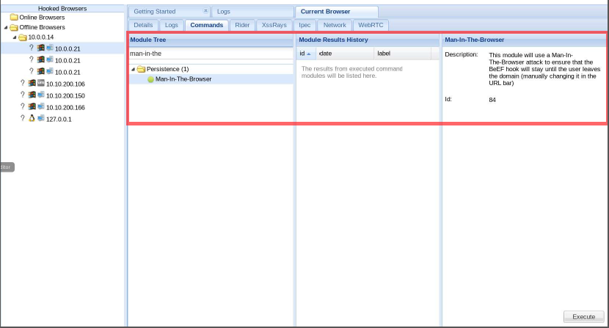
Retain Control

Slide 17
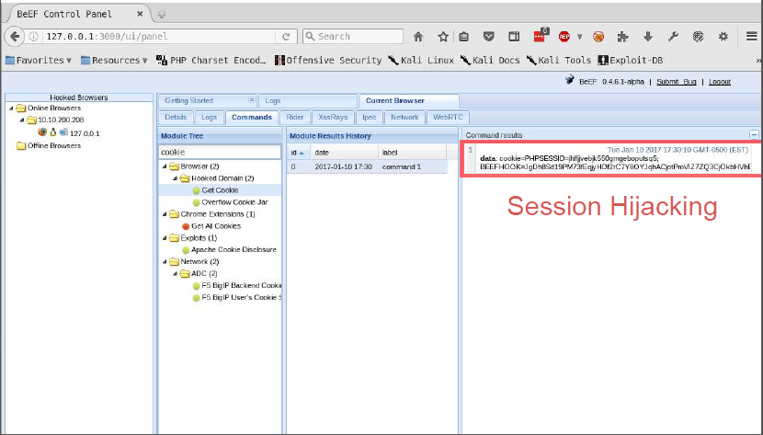
Attacking Users

Slide 18
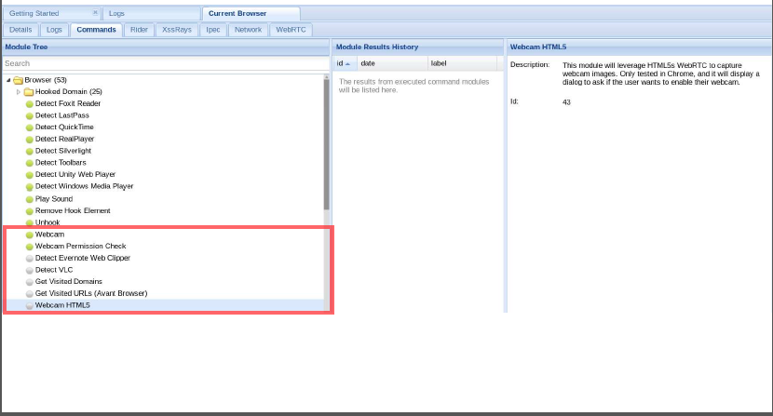
Webcam Control

Slide 19
Questions?

